Slide 1

ICICI Bank Management System
Shweta Agrey
© All rights reserved by Fireblaze Technologies Pvt. Ltd.

Slide 2
About the Data
In the provided database, we can view employee information, department structures, account types, customer profiles, and branch information for a banking institution.
Based on the analysis of various factors, we have gained insight into the performance of employees, branch efficiency, and customer behavior.
Banks can make strategic decisions based on the dataset, allowing for optimization, predictive analytics, and continuous improvement.
Using this information, the organization can make informed, data-driven decisions based on the rich and diverse information that it possesses.
© All rights reserved by Fireblaze Technologies Pvt. Ltd.

Slide 3
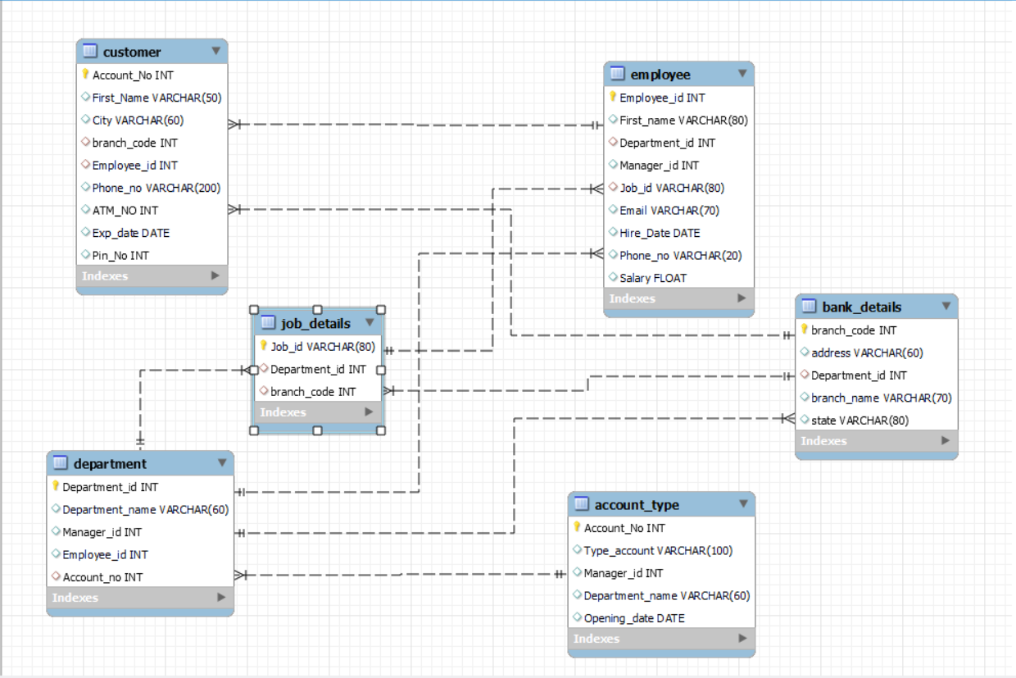
Problem Statement
© All rights reserved by Fireblaze Technologies Pvt. Ltd.

Slide 4
Problem Statement
Based on the data you've provided, here are a few problem statements that you could explore further
Employee Performance Analysis
Branch Efficiency and Customer Satisfaction
Account Type Distribution
Employee Salary and Job Role Correlation
Customer Behavior and Account Preferences
Branch Expansion Strategy
ATM Usage Patterns
© All rights reserved by Fireblaze Technologies Pvt. Ltd.

Slide 5
Proposed Solution
Here's a proposed solution for each of the identified points:
Implement regular performance assessments, provide targeted training, and establish a feedback process to improve employee performance.
Implement customer satisfaction surveys to gather feedback. Correlate branch efficiency metrics with customer satisfaction scores.
Custom made marketing strategies based on analysis of customer account preferences and behavioral trends.
Ensure fair compensation by analyzing correlations between employee salaries and job roles.
Utilize behavioral analytics to understand customer preferences, offering personalized services, targeted promotions, and improving overall customer engagement.
Conduct a thorough market analysis to identify high-potential locations, align expansion plans with customer demand, and consider demographic factors for strategic branch expansion.
Optimize ATM placement and functionality based on usage patterns, improving accessibility and customer experience.
© All rights reserved by Fireblaze Technologies Pvt. Ltd.

Slide 6
Future Scope
The scope of future use of the provided datasets and associated analyses may include various directions and opportunities for further investigation and improvement. Here are some potential future scopes:
Predictive Analytics for Employee Performance:
Implement machine learning models to predict employee performance based on historical data. This could involve using features such as employee demographics, job roles, and historical performance metrics
Real-time Performance Monitoring:
Implement real-time performance monitoring systems to detect performance anomalies or trends as they happen. This could involve integrating with employee tracking systems or incorporating feedback mechanisms.
Benchmarking Against Industry Standards:
Benchmark the employee performance against industry standards. This comparative analysis could provide insights into the bank's competitive positioning and highlight areas for improvement
© All rights reserved by Fireblaze Technologies Pvt. Ltd.

Slide 7
Future Scope
Employee Retention Strategies:
Investigate factors influencing employee retention and develop strategies to reduce turnover. This could involve analyzing correlations between salary, job satisfaction, and tenure.
Ethical AI and Bias Mitigation:
Ensure ethical considerations in the use of AI models, particularly in predicting employee performance. Implement strategies to mitigate biases and ensure fair and unbiased decision-making.
Integration with HR Systems:
Integrate performance analysis with HR systems for seamless access to employee data. This integration could improve efficiency in decision-making related to promotions, raises, and talent management.
© All rights reserved by Fireblaze Technologies Pvt. Ltd.

Slide 8
Conclusion
Accordingly, the provided dataset has provided valuable insights into the bank operations. We examined employee performance metrics, branch efficiency, customer demographics, and account details thoroughly. A structured approach is proposed for analyzing employee performance in order to improve productivity and optimize workforce efficiency. The identified correlations and trends offer actionable insights for immediate improvements. In the future, predictive analytics, real-time monitoring, and integration of data sources will be crucial for a deeper understanding of the data. With the dataset, the bank remains adaptable and successful in a dynamic financial environment with continuous strategic decision-making.
© All rights reserved by Fireblaze Technologies Pvt. Ltd.

Slide 9
Thank You
© All rights reserved by Fireblaze Technologies Pvt. Ltd.

